Slide 1
EPS - 1995 Impact of the Hon’ble Supreme Court Judgment dated 04.11.2022

Slide 2
EMPLOYEES’ PROVIDENT FUND & MISC. PROVISIONS ACT, 1952
EMPLOYEES’ PROVIDENT FUND SCHEME, 1952
EMPLOYEES’ PENSION SCHEME, 1995
(w.e.f. 16.11.1995)
EMPLOYEES’ DEPOSIT LINKED INSURANCE SCHEME, 1976
(w.e.f. 01.08.1976 )

Slide 3
EPS
1995
Introduced on 16.11.1995 [GSR 748(E )]
Applicability:
PF & FPF subscribers as on 16.11.1995 and PF joinees thereafter
Eligibility : Min. 10 years
Funding : Employer Contribution : 8.33% max. of PF Wage limit
GOI : 1.16%
Nature : Defined Benefit Scheme
FFF + EPS
Purpose : Social Security to Member and Family

Slide 4
Benefits under EPS95
For the employee / member
Superannuating Pension
For beneficiaries of employees / member
Widow / Widower’s Pension
Early Pension
Permanent Total Disablement Pension
Children Pension
Orphan Pension

Slide 5
EPS-95 Implementation
Introduced vide GSR 748(E) dated 16.11.1995
Organization /Unions/Associations objected the implementation of EPS-95
Court cases filed in different HCs and stay orders were issued.
Application for exemption from EPS-95 was filed with the EPFO
SC on 11.11.2003 upheld the validity of scheme (OTIS Elevators Employees Union Vs Union of India).
EPS-95 scheme was finally implemented across organization in the country
EPFO issued circular in Feb. 2004 for implementation of EPS-95 Scheme

Slide 6
Amendments in EPS -95
1996
[GSR 134 dated 28.02.1996]
Introduced Options for:
Contribution on higher wages exceeding the statutory limit (Para – 11)
2008
[GSR. 688(E) dated 26.09.2008]
Commutation (Para 12 A
2004
[EPFO circular No. Pen 4(38)/96/WB/59867 dated 01.12.2004]
Option to Contribute on Higher Wages was stopped.
Return of Capital (Para 13)
However, the members who were already contributing on higher wages before this notification were allowed to contribute on higher wages.
The Option for commutation and Option for Return of Capital were deleted with effect from 26.09.2008
2014
[G.S.R. No.609 (E) dated 22.08.2014 and circulated vide EPFO circular No. Acturial/18(2)2008/Vol.III/7738 dated 29.08.2014 ]
Omitted proviso to clause 11 (3) i.e. option to contribute on actual salary

Slide 7
Highlights of EPS-95 Amendment made in 2014
Wage ceiling raised to ₹ 15000/-. New employees with salary above ₹ 15000/- not eligible for EPS-95
Pensionable salary on last 60 months average pay (earlier last 12 months)
Benefits determined on pro-rate basis for contribution periods of ₹ 6500/- and ₹ 15000/-.
Pensionable Salary computed on proportionate basis in 2 parts – i.e. upto 31.08.2014 on ₹6500/- and w.e.f. 01.09.2014 on ₹15000/-
Deletion of para-11(3) to submit option to contribute on actual salary and Submission of fresh option within 6 months from 01.09.2014.
Addl. contribution @1.16% of Salary exceeding ₹ 15000/- by members who opt pension on higher/actual salary
Option to contribute till 60 yrs. of age and draw higher Pension.

Slide 8
Pension computation under EPS95
FPF Pension
EPS Pension (upto 31.08.2014)
EPS95 Pension
EPS Pension (beyond 01.09.2014)
Eligible Services
Eligible services = Actual Services + Past Services before 16.11.1995
Minimum 10 years of eligible service required for member pension
No new members after 01.09.2014* (pay Rs.15000/- & above)
Pensionable Service
Pensionable Service = No. of years for which contribution for the pension fund is made + 2 years, in the case of the member who attained the age of 58 years and has rendered 20 years pensionable service or more
Pensionable Salary*
12 months average pay | Maximum Rs. 6,500/- (prior to 01.09.2014)
60 months weighted average pay | Max. Rs. 15,000/- w.e.f 01.09.2014
Pension computation Formula:
Monthly Member Pension = Pensionable Salary x Pensionable Service
70

Slide 9
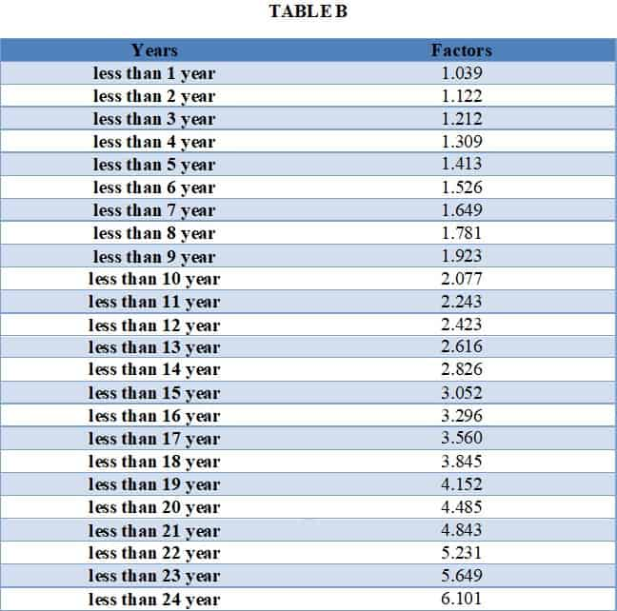
Pension computation under FPF-71
Past Service Pension calculation formula:
Depends upon length of service prior to 16.11.1995, age and salary as on 16.11.1995.
Past Service Pension = Amount under Table -A multiplied with Factor given in Table-B according to the difference between 16.11.1995 and superannuation date i.e. date of completion of 58 years.
Back

Slide 10
Court Cases on EPS95 leading to SC judgment dated 04.11.2022
During the period 2004 to 2014 many cases were filed in various High Courts, praying for payment of pension on higher wages by allowing contribution on higher wages under the pension scheme.
Hon’ble Kerala High Court in R.C. Gupta & Ors. Vs. RPFC, EPFO & Ors. Civil Appeal Nos. 10013-10014 Of 2016 held PF Authorities had no power to fix any cut-off date for exercising the option and to contribute on higher salary of EPS-1995.
EPFO appealed to the Hon’ble Supreme Court.
SLP (C) Nos. 16721-16722 of 2019 & Review petitions by EPFO, appeal by the GOI assailing the judgement of Division Bench of Kerala HC was dismissed by the co-ordinate bench of the SC vide its order dt. 01-04-2019.
54 Writ Petitions were filed by the employees or on their behalf (from unexempted & exempted estab.) under Article 32 seeking invalidation of the notification dated 22nd August 2014
Review petition filed by EPFO. Union of India also filed appeal in the SC against the orders of HCs.
SC admitted the review petition & GOI appeal and allowed the review and recalled its earlier order dated 01.04.2019.
Many contempt petitions were also filed by the aggrieved parties w.r.t. non-compliance of SC Judgement in the R.C. Gupta case of 2016 by the EPFO and non-sanction of higher pension as per the order to all EPS Members.

Slide 11
SC Order dated 04.11.2022 (Arising out of the Special Leave Petition (C) Nos. 8658-8659 of 2019) with other SLPs and WPs EPFO Vs Sunil Kumar B.)
Notification dated 22nd August 2014 of EPFO is legal and valid.
The requirement of members to contribute at the rate of 1.16 % of their salary to the extent such salary exceeds Rs 15000/- p.m as an addl. contribution under the amended scheme held ultra vires of the 1952 Act. This part of the order remains suspended for 6 months.
Amendment to the pension scheme shall apply to employees of exempted establishments
Emp. who had exercised option & continued in service as on 01.09.14 will be guided by amended prov. of scheme.
Members of the scheme shall exercise option jointly covering pre and post amended features of the scheme. Four months more time w.e.f 4.11.2022 given to employees under Art 142 of GoI.
Emp. who had retired prior to 01.09.14 without exercising option under pre-amended scheme not entitled to the benefits
Retirees before 01.09.2014 who have exercised option under para 11(3) shall be covered under the scheme as it stood before the amendment of 2014.

Slide 12
SC Order dated 04.11.2022 (Important points of SC order dated 04.11.2022 The EPFO & Anr. Vs. Sunil Kumr B. & Ors.)
Decision in favour of EPFO/GOI:
Amendments w.e.f. 01.09.2014 are valid and legal
Decision in favour of the employees/ Members of EPS-95
Members as on 01.09.2014, granted 4 months time to submit joint declaration & option to opt for contribution on actual salary and higher pension in line with unamended para-11(3) & 11(4) of the EPS-95 Scheme with an undertaking to remit arrears with applicable interest at the earliest.
No flaw in changed method of calculation of Pensionable Salary (i.e. 60 months average)
Retirees prior to 01.09.2014 without exercising option u/p 11(3) are not eligible for higher pension.
Members who continued beyond 01.09.2014 allowed to exercise option within 4 months by 03-03-2023.
Recovery of additional contribution @ 1.16% from employee held ultra vires. However, this part of order is suspended for next six(6) months.
SC Judgement in R C Gupta case and current judgement dated 04-11-2022 is to be implemented by EPFO within a period of two (2) months.
EPFO/GOI to make necessary arrangements to generate funds from alternate legitimate source within the scope of the Act, which could include enhancing the rate of contribution of the employers

Slide 13
Way Forward in GAIL
Task Force Formed
Informed to Eligible members on 29.11.2022
documentary proof on Salary from Site HR sought on 13.12.2022
VC with Site HR on 23.12.2022
Take up the matter with GAIL EPF Trust
Coordinate with EPFO for audit
Deposit Joint Option & Undertaking with EPFO
Merge Salary Data in SAP
Develop Online Facility for computation of PF arear and Joint Option cum Undertaking in Intranet
Take Joint Option from interested members.

Slide 14
EPS-95 Members in GAIL
Categories of Employees / Members | Active | Separated | Grand Total
Active - Less than 58 yrs age | 3564 |  | 3564
Active & above 58 age (deemed pensioners) | 282 |  | 282
Death/ Expiry |  | 80 | 80
Discharge/Dismissal/Removal |  | 4 | 4
Discharge/Dismissal/Removal - deemed pensioners |  | 1 | 1
Resignation |  | 118 | 118
Resignation - deemed pensioners |  | 5 | 5
Superannuated from other org |  | 1 | 1
Superannuation |  | 537 | 537
VRS |  | 2 | 2
VRS - deemed pensioners |  | 9 | 9
Grand Total | 3846 | 757 | 4603

